Slide 1
Cancer Genetic Counseling and
Familial Cancer Risk Assessment Program
Zohra Ali-Khan Catts, MS LCGC
Helen F. Graham Cancer Center
Christiana Care Health System
Delaware Cancer Consortium Retreat
February 20, 2012

Slide 2
Introduction
Familial Cancer Risk Program
    Familial Cancer Risk Registry (2002 to 2012)
      First and only program in the State
      3,175 Individuals
      Over 150,000 Family Members
    Family Registry Bio repository (2008 to 2012)
      690 samples from 607 families

Slide 3
Genetic Counseling Staff
    Staff: 4 Board Certified Genetic Counselors
      Zohra Ali-Khan Catts, MS LCGC
      Becky Milewski, MS LCGC
      Marcie Parker, MS LCGC
      Chandra Somerman, MS LCGC

Slide 4
Genetic Counseling and Program Services Expanded Across the State
New Castle County
  Helen F. Graham Cancer Center, Christiana Care Health System
    Genetic Counseling Services provided daily
  Wilmington Annex, Christiana Care Health System
    Genetic counseling Services provided once a month (2009- 2012)
  Westside Family Healthcare, federally funded community healthcare center
    Genetic counseling services are provided weekly (Jan. 2012 -2012)
Sussex County
  Tunnell Cancer Center, Beebe Medical Center
    Genetic counseling services are currently provided weekly (2002 to 2012)
  Nanticoke Hospital-
    Potential for genetic counseling services
Maryland
  Union Hospital, Elkton Maryland (2009 to present)
    Genetic Counseling services provided bi-monthly

Slide 5

9% (285/3175) Pennsylvania
*HFGCC
3 % (95/3175) from New Jersey and points further north
61% (1937/3175)
11.0% (349/3175) Maryland
5% (159/3175)
*Tunnell Cancer Center
11% (349/3175)

Slide 6
Increasing patient encounters
Patient encounters per year

Slide 7
2002 - 2011 Uptake in Genetic Testing at the HFGCC is 82%
Published data ranges from 26-78% ;average 57-60%

Slide 8
Genetic testing per year

Slide 9
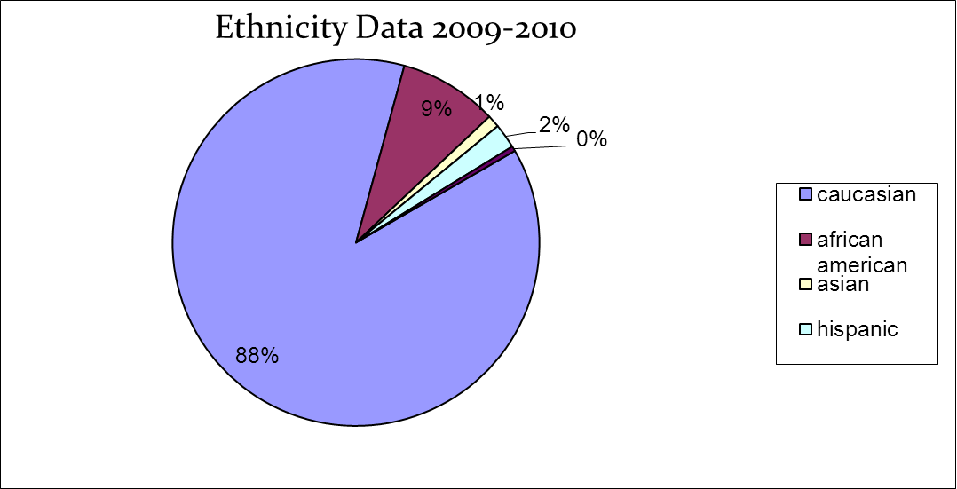

Slide 10
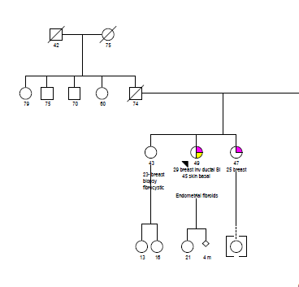

Slide 11
HBOC

Slide 12
Bilateral breast cancer at 29

Slide 13
The Importance of Genetic Diagnosis
100
With mutation
Prophylactic Surgery
Chemo prevention
Increased surveillance
Probability of cancer (%)
50
Family History
(without testing)
Without mutation
30
50
70
Age (Years)
Each child of a carrier has a 50-50 chance of being at increased risk (or not).
Adapted with permission from Ponder B: Genetic Testing for Cancer Risk. Science 1997; 278:1050-4.
Copyright 1997 American Association for the Advancement of Science
Notes:
Slide 14
The Importance of Genetic Diagnosis
The identification of a specific mutation responsible for HNPCC through genetic testing not only guides the medical care of an individual but can also allow family members who did not inherit the causal mutation to avoid unnecessary interventions.
MMR germline mutations are inherited in an autosomal dominant fashion and each offspring has a 50% chance of inheriting the mutation, or not. Those who did not inherit the mutation have the same risk of cancer as the general population, despite having a strong family history. Therefore, siblings with an identical strong family history can have dramatically different cancer risks. Those who inherited the mutation have a greatly increased risk of cancer, whereas those relatives who do not have the mutation are at the general population risk of cancer despite having a strong family history.
Relying solely on family history can underestimate the risk of developing cancer in mutation carriers and over-estimate risk in those who do not inherit the deleterious mutation.When an individual has a personal or family history that suggests the possibility of HNPCC, an important step is therefore to determine whether the person is interested in genetic testing.

Slide 14
Hereditary Colon Cancer
Identification and referral of individuals at risk for colon cancer is problematic nationally
  Wider variety of associated cancers
  Wide variation in age of onset of cancer
    Ohio state study mean age of colon cancer diagnosis was 60

Slide 15
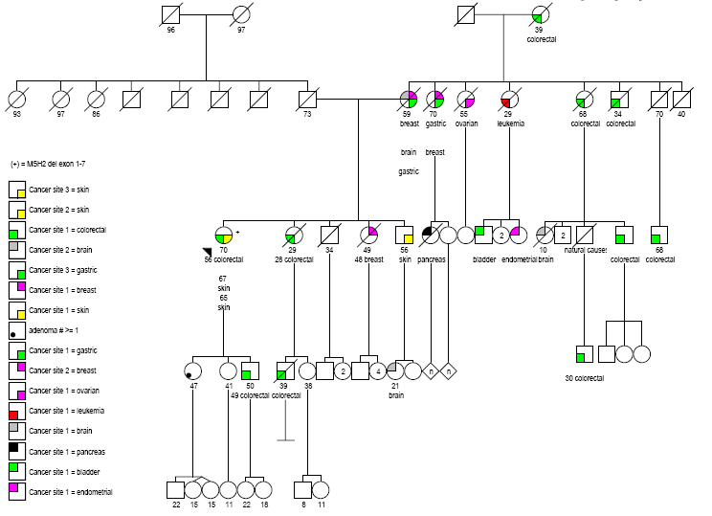
Lynch Syndrome

Slide 16
Helen F. Graham Cancer Centers resolution
Universal screening for Lynch syndrome –
  Implemented on December 5, 2011- all colon and endometrial cancers
  Pilot data – MSI/IHC on all colon cancers – 1 practice
    Showed increased detection of individuals at risk for hereditary colon cancer syndrome
      50% prior to pilot
      88% during pilot

Slide 17
HFGCC Experience in Genetic Testing.
82% of counseled patients accepted genetic testing.
57-60% for the National average
Reasons for higher genetic testing
  Community presentations- lay and professional
  Multidisciplinary disease site centers
  Genetic Counselors going into the community to provide services.

Slide 18
Outcomes: Impact of Genetic Testing
Mutation carriers- 90-95% have had an impact on health care management
  Prophylactic Surgery
  Increased Surveillance
  Participation in Clinical Trials

Slide 19
Genetic Counseling Licensure
Delaware leading the way:
  Genetic Counseling licensure was passed in 2010
  Division of Professional Regulation - Board of Medical Practice started issuing licenses in 2011.
  Delaware is the 8th state to issue Licenses to Genetic Counselors

Slide 20
Collaborations
University of Delaware
  Mentor undergraduate students who are interested in Genetic Counseling
  Adjunct scientist appointments with the Department of Biological Sciences
  Planning an advanced degree in genetic counseling
Arcadia University and University of Maryland
  Clinical rotation site for Master level genetic counseling students.

Slide 21
Goals
To continue to expand services across the state of Delaware- targeting Sussex and Kent Counties
Provide educational opportunities for professionals and lay individuals
Physical presence at the federally funded community health centers (Westside and HJMC)
Increase Grant Funding and Publications

