Slide 1

Cancer-Related Behavioral Risk Factors of Delaware Adults: 2009-2010 Data
from the Delaware Behavioral
Risk Factor Survey (BRFS)
Cancer Consortium Retreat, February 20, 2012

Slide 2



Adult Data from BRFSS
Behavioral Risk Factor Surveillance System (BRFSS) is a core public health system which gathers data on behavioral risks for leading causes of premature death, disability and illness.
U. S. Centers for Disease Control and Prevention (CDC) in partnership with all 50 states, D.C., and three territories
State-based samples
National core questionnaire, with optional modules and state-added questions

Slide 3


Behavioral Risk Factor Survey (BRFS)
Random-sample telephone interview survey of non-institutionalized adult Delaware residents
Ongoing survey; data reported on calendar-year basis
Annual sample size > 4,000 adults age 18 and older
Stratified by county since 2000, and now Wilmington
Interviewing conducted by U.D. Center for Applied Demography and Survey Research (CADSR)

Slide 4
Limitations
Does not include institutionalized adults
Self-reported data
Declining response rates in all surveys due to social and technological changes
Landline calls only from 2005 to 2010
Rapidly increasing proportion of “cell phone only” and “cell phone primarily” households, especially among young and minority populations

Slide 5
Cell Phone-Only Varies by Region
Lowest prevalence in Northeast, and West
Highest prevalence in Central and South

Slide 6
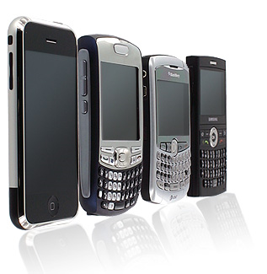
Rapidly Changing Trend
Source: National Center for Health Statistics, National Health Interview Survey, reported in National Health Statistics Reports, 39, April 20, 2011.

Slide 7


How the BRFSS is Adapting
We tested cell phone interviewing in 2009 and 2010
Other methods are being explored and tested, including:
  Internet follow-up survey
New method of “weighting” the data to make it conform more closely with the real population of Delaware, based on 2010 census.
  From standard weights to “raking” weights

Slide 8
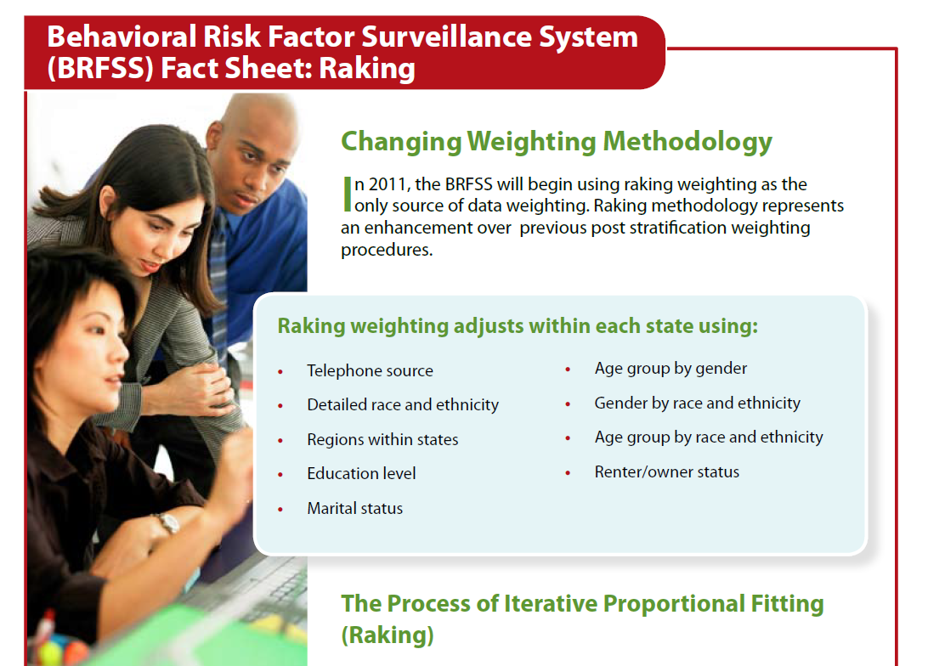

Slide 9

Changeover This Year
BRFS is now a multi-mode survey
2011 data – to be released early in 2012 – will be reported with combined modes and new weights.
2011

Slide 10
What These Changes Will Mean
Breaks in trend lines
2011 will be new baseline for many items
Data will more accurately reflect the population
  Young adults, males, and minorities will be more accurately represented
Some prevalence rates will change significantly
  e.g. smoking prevalence; health insurance status

Slide 11

Delaware Adult Tobacco Use

Slide 12
Source: Delaware Health & Social Services, Division of Public Health, Behavioral Risk Factor Survey (BRFS), 1997-2010.

Slide 13
Current Smoking x Income & Education
2010 BRFSS Income Level | Smoking Prevalence
$15,000 - $24,999 | 29.6%
$25,000 - $34,999 | 29.5%
$35,000 - $49,999 | 19.9%
$50,000 - $74.999 | 18.4%
$75,000 + | 9.7%
2010 BRFSS Educational Level | Smoking Prevalence
High School or G.E.D. | 24.6%
Some Post-High School | 17.9%
College Graduate or Higher | 7.3%
Source: DHSS, Division of Public Health, Behavioral Risk Factor Survey (BRFSS) , landline sample only, 2010.

Slide 14


Other 2010 Tobacco Information
59.9% of adult Delaware smokers have tried to quit during the past year (2010 BRFS)
3.2% of adult males use chewing tobacco, snuff, or snus either every day or some days (2010 BRFSS)
  Compared with 0.2% of adult females
  More likely white, poorly educated, and young
Among adults who do not smoke cigarettes, about 2.6% use other tobacco products. (2010 ATS)

Slide 15
Change In Smoking Initiation?
According to the 2009 YRBS, about 13.3% of public high school seniors were current regular smokers.
According to the 2009 BRFS, about 18% of 18-24 year olds were current smokers.
Why the gap?
  Higher smoking prevalence among school drop-outs?
  Marketing to college-age adults by tobacco industry?
  Initiation by adults in their twenties?
It may no longer be true that “if you haven’t started by 18 you’re not likely to start smoking.”
Sources: DOE/CDC , Youth Risk Behavior Survey (YRBS), 2009; DHSS, DPH, Behavioral Risk Factor Survey (BRFS), 2009.
Notes:
Trends for “ever smoked cigarettes” have been declining for middle and high school students, and for adults 35-44. For 18-34-year-olds the trend line is relatively flat.

Slide 16
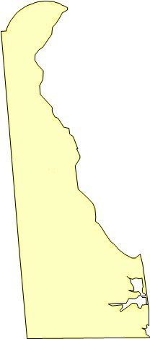
Smoking by County: 2010
(landline data only)
County | Smoking Prevalence
New Castle County | 15.9%
Kent County | 20%
Sussex County | 19.1%
Source: Delaware Health & Social Services, Division of Public Health, Behavioral Risk Factor Survey (BRFS), landline, 2010.

Slide 17
Sources: DOE, Youth Risk Behavior Survey (YRBS) - Odd Years / DHSS,DPH, Youth Tobacco Survey (YTS) - Even Years

Slide 18



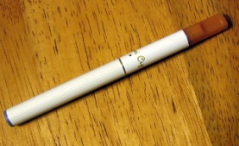
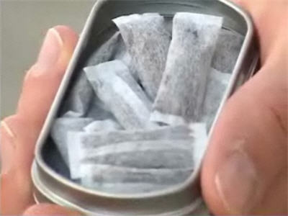

Problems with 2009-10 data:
The BRFS adult prevalence rate is actually higher than reported for the past 2-3 years.
Probable reasons include:
  Cell phones – improved sampling
  New tobacco products
  Changing tobacco use patterns
  Economic recession

Slide 19
Are you ready?
Impact of Cell Phone Sample:
The next few slides show the difference that addition of a pilot cell phone sample made in the overall prevalence rate for cigarette smoking.
These numbers are preliminary – and from a pilot sample. They should not be cited as the actual prevalence rate for 2010. The rates in slide 19 are provided for illustration purposes only.

Slide 20


Slide 22

Alcohol Use and Abuse

Slide 23

Alcohol Use Among DE Adults
Nearly 60% of Delaware adults drink alcoholic beverages.
  They report having had at least one alcoholic drink during the past month.
Delaware Adults Drinking During Past Month, 2010
Total Adults | 59.3% (57.1-61.5%)
Males | 68.3% (65.2-71.4%)
Females | 51.1% (48.6-53.6%)
White (non-Hispanic) | 63.8% (61.6-66%)
African American | 42.3% (35.6-49%)
Source: Delaware Health & Social Services, Division of Public Health, Behavioral Risk Factor Survey (BRFS), landline sample, 2010.

Slide 24

“Binge” or Acute Drinking
18.8% (ci 16.6-21%) of Delaware adults report binge drinking during the past month
  26.4% (22.5-30.2%) of males
  12% (10-13.9%) of females
Slightly higher than the national median of 15.1%
For this survey, “binge” drinking is defined as males having five or more drinks on one occasion, females having four or more drinks on one occasion.
Source: Delaware Health & Social Services, Division of Public Health, Behavioral Risk Factor Survey (BRFS), 2010. Landline sample only.

Slide 25
Binge Drinking by Race
& Education – a somewhat different picture
“Binge” Drinking Among Delaware Adults, 2010
White (non-Hispanic) | 20.8% (18.4-23.2%)
African American | 10.3% (4.2-16.3%)
Hispanic | N/A
High School or G.E.D. Education | 19.2% (15.4-23.0%)
Some Post High School Education | 19% (14.2-23.8)
College Degree or Higher | 17.8% (14.8-20.8)
Binge drinking also increases somewhat with income, from 11% (< $15,000/year) to 22.5% (over $50,000/year).
Source: Delaware Health & Social Services, Division of Public Health, Behavioral Risk Factor Survey (BRFS), 2010.
Landline data only.

Slide 26
Binge Drinking by Age
Delaware Adult Binge Drinking by Age, 2010
18-24 Years Old | N/A*
25-34 Years Old | 25.8% (19.3-32.3%)
35-44 Years Old | 19.7% (15.6-23.8%)
45-54 Years Old | 19.5% (16-23%)
55-64 Years Old | 13.1% (10.2-16%)
65 + | 3.5% (2.3-4.7%)
* BRFSS suppression rules remove cells that contain less than 50 observations or which have a confidence interval with a half-width greater than 10. However, this is undoubtedly the group with highest prevalence, based on looking at combined data.
Source: Delaware Health & Social Services, Division of Public Health, Behavioral Risk Factor Survey (BRFS), 2010.

Slide 27
No Change in Recent Years
Source: Delaware Health & Social Services, Division of Public Health, Behavioral Risk Factor Survey (BRFS), 2010.
Landline sample only.

Slide 28
Chronic Heavy Drinking
5.9% (4.7-7.1%) of Delaware adults report heavy drinking.
  “Heavy drinking” is defined for this survey, as more than 2 drinks per day for men, and more than 1 drink per day for women.
6.7% (4.7-8.7%) of males
5.1% (3.9-6.3%)of females
Delaware’s prevalence is about the same as the national median of 5%.
Source: Delaware Health & Social Services, Division of Public Health, Behavioral Risk Factor Survey (BRFS), 2010.
National data from CDC, Behavioral Risk Factor Surveillance System (BRFSS), 2010. Landline samples only.

Slide 29
Heavy Drinking by Race & Education
Delaware Adults: Heavy Drinking, 2010
White (non-Hispanic) | 6.8% (5.4-8.2%)
African American | 1.8% (0.2-3.4%)
Other Races (non-Hispanic) | 4.3% (0.6-8%)
Hispanic | 6.8% (0-15.8%)
Educational Level
Less Than High School Education | 9.7% (2.6-16.8%)
High School or G.E.D. | 6.4% ( 4.2-8.6%)
Some Post High School Education | 5.8% (3.3-8.3%)
College Degree or Higher | 5% (3.6-6.4%)
Source: Delaware Health & Social Services, Division of Public Health, Behavioral Risk Factor Survey (BRFS), 2010.
Landline sample only.

Slide 30
Little Change in Adult Heavy Drinking
Source: Delaware Health & Social Services, Division of Public Health, Behavioral Risk Factor Survey (BRFS), landline 2001-2010.

Slide 31
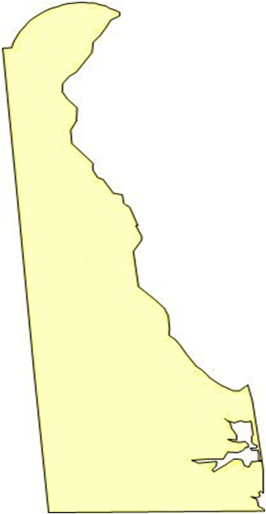
Alcohol Abuse by County:
(landline data only)
County | Heavy Drinking | Binge Drinking
New Castle | 6.5% | 21%
Kent | 4% | 14%
Sussex | 5.6% | 16.8%
Source: Delaware Health & Social Services, Division of Public Health, Behavioral Risk Factor Survey (BRFS), landline, 2010.

Slide 32
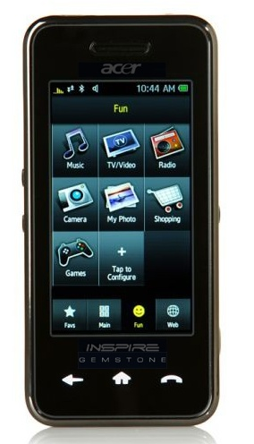
Cell Phone Impact
Addition of the cell phone sample in 2010 had no impact on the overall prevalence rate for binge drinking:
  Landline = 18.8%; LLCP/new weights = 18.7%
The impact on prevalence of heavy drinking was insignificant:
  Landline = 5.9%; LLCP/new weights = 6.3%
Source: DHSS, Division of Public Health, Behavioral Risk Factor Survey (BRFSS), combined data, 2010.

Slide 33


Overweight, Obesity & Nutrition

Slide 34
BMI ≥30
BMI <25
Source: Delaware Health & Social Services, Division of Public Health, Behavioral Risk Factor Survey (BRFS), multi-mode, 2010.

Slide 35
Weight by Gender, Education: 2010
(landline data only)
Demographic | Overweight | Obese
Male | 42.1% | 29.2%
Female | 28.7% | 28.3%
< H.S. Education | 27.6% | 31.3%
High School | 37.5% | 30.8%
Some Post H.S. | 33.6% | 32.8%
College Graduate | 36.2% | 23.8%
Source: Delaware Health & Social Services, Division of Public Health, Behavioral Risk Factor Survey (BRFS), landline , 2010.

Slide 36
Obesity by Income, 2010
(landline data only)
Income Level | Overweight | Obese
< $15,000/yr | 30.9% | 38.1%
$15,000-24,999 | 28.8% | 37.2%
$25,000-34,999 | 31.3% | 31%
$35,000-49,999 | 40% | 33.5%
$50,000-74,999 | 33.9% | 32.3%
≥$75,000 | 38.4% | 22.8%
Source: Delaware Health & Social Services, Division of Public Health, Behavioral Risk Factor Survey (BRFS), landline , 2010.

Slide 37
Source: Delaware Health & Social Services, Division of Public Health, Behavioral Risk Factor Survey (BRFS), landline only, 2010.

Slide 38
Source: Delaware Health & Social Services, Division of Public Health, Behavioral Risk Factor Survey (BRFS), 1990-2010.

Slide 39

Source: Delaware Health and Social Services, Division of Public Health, Behavioral Risk Factor Survey (BRFS), 2005-2010.
Overweight = BMI 25-29.9; Obese = BMI ≥30

Slide 40
(landline only)
Source: Delaware Health & Social Services, Division of Public Health, Behavioral Risk Factor Survey (BRFS), landline data only, 2010.
Overweight = BMI 25-29.9; Obesity = BMI ≥30.

Slide 41
Source: Delaware Health & Social Services, Division of Public Health, Behavioral Risk Factor Survey (BRRS), 2000-2010.

Slide 42
Obesity & Overweight x County
(landline data only)
County | Overweight | Obese
New Castle | 33.3% | 26.8%
Kent | 38.8% | 31.9%
Sussex | 37.7% | 31.8%
Source: Delaware Health & Social Services, Division of Public Health, Behavioral Risk Factor Survey (BRFS), landline, 2010.

Slide 43

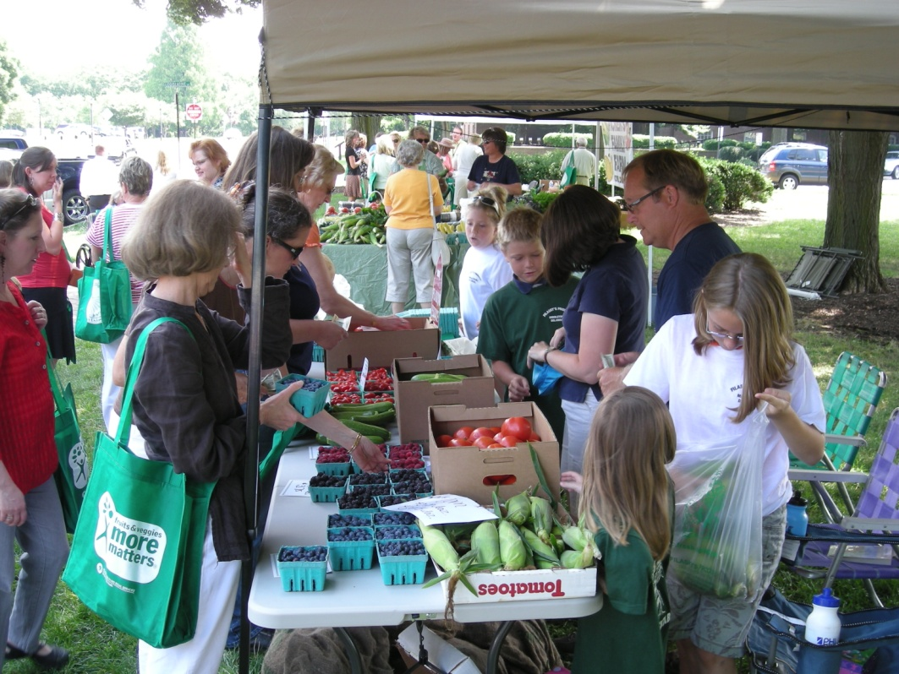

Fruits and Veggies

Slide 44
Source: Delaware Health & Social Services, Division of Public Health, Behavioral Risk Factor Survey (BRFS), landline only, 2000-2009. Questions asked in alternate years.

Slide 45



Healthy Physical Activity

Slide 46
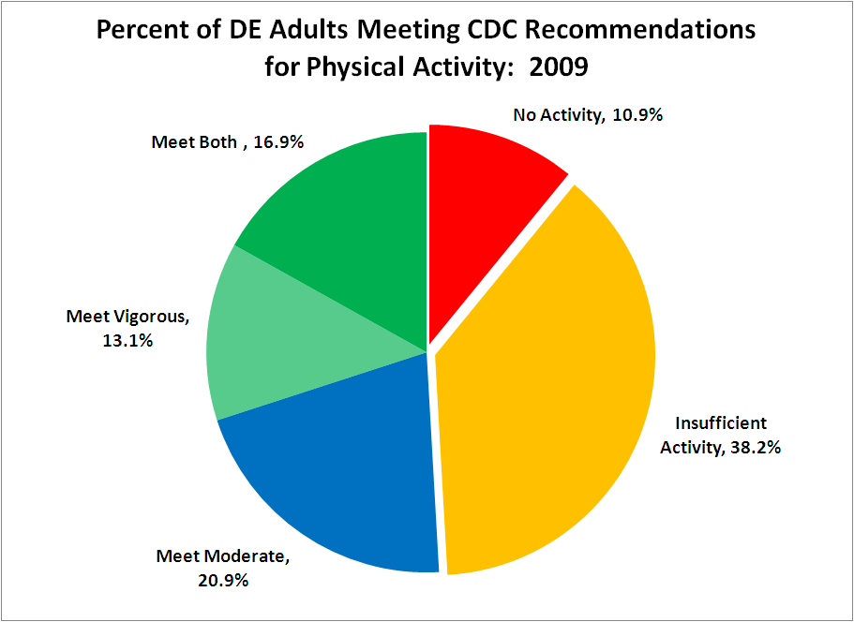
Source: Delaware Health & Social Services, Division of Public Health, Behavioral Risk Factor Survey (BRFS), landline only, 2009.

Slide 47
Slow, but Steady Improvement
Source: Delaware Health & Social Services, Division of Public Health, Behavioral Risk Factor Survey (BRFS), 2003-2009.
Questions asked in odd-numbered years. *2009 data are combined landline-cell phone sample with raking weights.

Slide 48
Physical Activity: 2009
Decreases steadily with age, from 58.3% of 18-24 year olds to 41.3% of those over 65.
Most of the older adults meet only the recommendations for moderate activity.
Meeting recommendations for both (moderate and vigorous activity) increases with income and education.
Moderate activity is not significantly impacted by education or income.
Men (53.8%) are more likely to meet recommendations than women (48.3%).
There is no significant difference by race/ethnicity.
Source: Delaware Health & Social Services, Division of Public Health, Behavioral Risk Factor Survey (BRFS), 2003-2009.
Questions asked in odd-numbered years.

Slide 49

Cancer Screening
colonoscopy, mammography, Pap testing, prostate

Slide 50
Improvement in CRC Screening
Delaware is in the top 5 states in the nation for prevalence of colorectal screening.
For the past three years, there has been no significant disparity between rates for white and African American adults.
We do not yet know if the addition of cell phone sampling and new weights will affect the CRC screening data.

Slide 51
Source: Delaware Health & Social Services, Division of Public Health, Behavioral Risk Factor Survey (BRFS), 1999-2010.

Slide 52
Source: Delaware Health & Social Services, Division of Public Health, Behavioral Risk Factor Survey (BRFS), 2004-2010.

Slide 53
Source: Delaware Health & Social Services, Division of Public Health, Behavioral Risk Factor Survey (BRFS), landline, 2008-2010.

Slide 54
2012 Extra PSA Questions
Decision making module
Which of the following best describes the decision to have a PSA test done?
  You made the decision alone
  Your doctor, nurse or health care provider made the decision alone.
  You and one or more other persons made the decision together.
  You don’t remember.
Who made the decision with you?

Slide 55
Source: Delaware Health & Social Services, Division of Public Health, Behavioral Risk Factor Survey (BRFS), landline, 2000-2010.

Slide 56
Source: Delaware Health & Social Services, Division of Public Health, Behavioral Risk Factor Survey (BRFS), landline, 2000-2010.

Slide 57
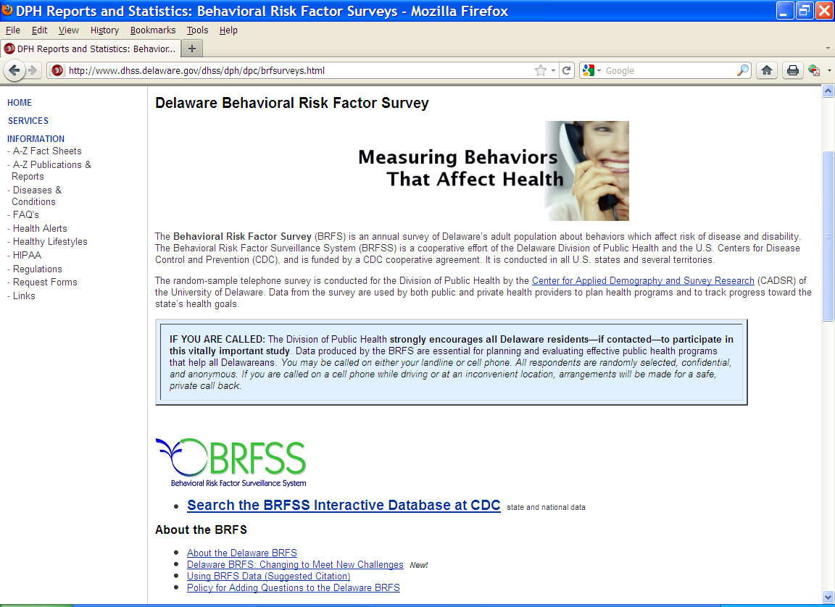
BRFS on the Web
dhss.delaware.gov/dph/dpc/brfsurveys.html

