Slide 1
Indian River Power Plant (IRPP) Impact Study
An Overview
DCC Annual Retreat
February 20, 2012
Notes:
Good morning everyone- My name is Meg Maley and I am the Chair of the Delaware Cancer Consortium’s Environment Committee.
I am here to provide an overview of the Indian River Power Plant Impact Study- being conducted by the Division of Public Health (DPH) and Delaware Department of Natural Resources and Environmental Control (DNREC) in collaboration with the Research Triangle Institute (RTI).

Slide 2
How Did We Get Here?
December, 2006 - Sussex County residents request DPH investigation into perceived elevated lung cancer rates near the Indian River area
July, 2007 - DPH releases findings from initial investigation - 2000-04 lung cancer incidence rate for the area significantly elevated compared to rates for Sussex County, DE, and U.S.
March, 2008 - In 2008, DPH initiated the Indian River Community-Level Survey (IRCLS)- a survey- based study designed to collect risk factor data from Sussex County residents to begin answering the question of WHY lung cancer rates are elevated in the area.
November, 2009 - Findings from the IRCLS strongly pointed to tobacco use as the major contributing lung cancer risk factor in the Indian River area. Investigate beyond tobacco use as a risk factor for lung cancer in future research
Notes:
For nearly a decade the Delaware Cancer Consortium has been discussing the need to collect exposure data to determine what is showing up in people’s bodies in Delaware.
Over the years, the DCC worked with Research Triangle Institute (RTI) to draft a study plan for a multi-media exposure study (body burden). Unfortunately, as you may know this type of study can be quite expensive. However, throughout the past four years, the DCC, DPH and DNREC have continued discussions and looked for possible ways to put the study into action.
Due to expressed citizen concerns and increase lung cancer rates in the Millsboro area in close proximity to the Indian River Power Plant, the organizations found away to develop a pilot study.
Which I will tell you about today…
Let me begin by providing the background and rationale for this study.
In December 2006, Sussex County residents request DPH investigation into perceived elevated lung cancer rates in the Indian River area.
In July 2007, DPH released findings showing that the 2000-04 lung cancer incidence rate for this area was significantly greater than the rates for Sussex Co., Delaware, and the U.S.
DPH planned a follow-up study to investigate why lung cancer rates were elevated in this area. The follow-up study i.e the Indian River Community Level Survey was designed specifically to collect risk factor data among Sussex County residents diagnosed with lung cancer.
Findings from this investigation were released in November, 2009. Results from this study strongly pointed to tobacco use as the major cause for the elevated lung cancer rates in the area. However, it was suggested that in the future, researchers may chose to investigate whether geographic proximity to the IRPP influences residents’ lung cancer risk beyond that of tobacco use through collection of meteorological, environmental and/or biomonitoring data.

Slide 3
What’s Happening?
2010- 2011
DPH and Delaware Department of Natural Resources and the Environmental Control (DNREC) in collaboration with the Research Triangle Institute (RTI) plan and design the Indian River Power Plant Impact study to investigate the impact of geographic proximity to the IRPP on exposure levels of residents.
October 2011
IRPP study launched.
Primary purpose is to determine the impact of the Indian River Power Plant emissions on the exposures of the surrounding population of Sussex County.
Notes:
And thus was laid the foundation for the current Indian River Power Plant Impact study.
DPH and Delaware Department of Natural Resources and Environmental Control (DNREC) in collaboration with the Research Triangle Institute (RTI) plan and design the Indian River Power Plant Impact study.
In October 2011, the sample collection begins
In the forthcoming slides, I will be talking about the specifics of the study design.

Slide 4
Objectives
Evaluate the impacts of the IRPP operating capacity on particulate matter exposure levels of the Sussex County population.
Ascertain the relative contributions of upwind sources in Maryland, Pennsylvania, and Virginia on the particulate matter exposure of the Sussex County population.
Collect biological samples for dose measurements of the Sussex County population
.
Notes:
The objectives of the study are as follows:
The primary purpose is to evaluate the impacts of the emissions of the Indian River Power plant on the exposures of the residents of Sussex County. For this purpose air sample will be collected in a variety of locations. I will be discussing them in detail.
The impact of upwind sources outside of Delaware will also be monitored. Meteorological data will be used for this purpose.
Blood , hair and urine samples will be collected from each participant.

Slide 5
Benefits
Improved understanding of the range and magnitude of the emissions from the IRPP that affect the surrounding counties and how those emissions change depending on IRPP operating loads.
Assessment of baseline exposure
Recognition of time trends in exposure
First step towards a larger statewide study.
Notes:
Benefits of the study-DNREC and DHSS will have an improved understanding of the range and magnitude of the emissions from the IRPP that affect the surrounding counties and how those emissions change depending on IRPP operating loads.
Biomonitoring will provide a baseline of exposure levels.
Measuring biomarkers over two seasons will give an idea regarding the trends in exposure.

Slide 6
Limitations
Only a snapshot of exposure
Exposure ≠ Disease
Cannot reveal exposure sources or routes
Influence of personal behaviors, genetics
Unknown additive/synergistic effects of chemicals
Will not identify who will or will not develop a disease endpoint
Notes:
Every study has its limitations and this is no different.
The biomonitoring being done in this study will only provide a snapshot of the exposure. We will not be assessing chronic exposure. Exposure sources will not be revealed through the study. Influence of personal behaviors is not being taken into account.
The study has only limited health risk information. Science associated with biomonitoring is still evolving. There are no health effects conclusively linked to individual low-level exposure for the majority of chemicals.

Slide 7
Study Type?
Involves two months of air monitoring plus collection of biological samples.
October 2011 and October 2012.
Study Design?
Study Area, Sample size, Recruitment,
Samples (Environmental, Biological), Analyses and Results, Cost, Future directions
Notes:
In order to develop the best air quality standards to make the air safe, we need to understand what is in the air that you breathe and how it changes over time. This study involves two months of air monitoring in the Indian River Power Plant Area. Biological samples are also being collected.
The study is being conducted over two time periods, October 2011 and October 2012. Study participants will be asked to participate for 4 consecutive days during October of 2011 and again during October of 2012- a total of 8 days participation during a one year period.
I will be outlining the specifics of the study design in regards to the study area, participant recruitment and sample size, collection of samples, analyses , results and future directions.

Slide 8
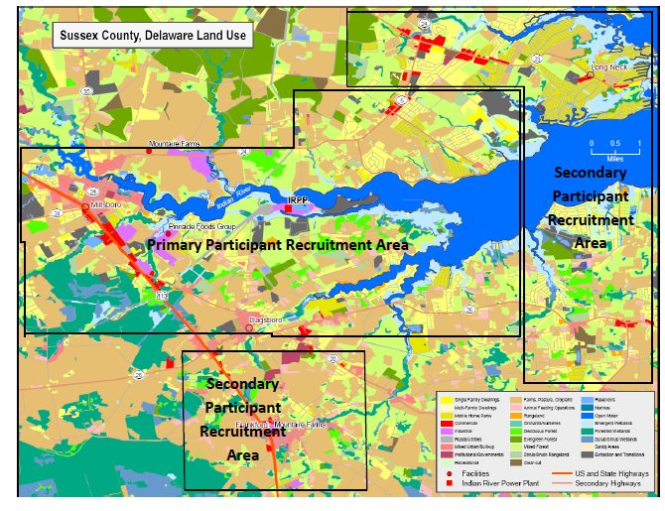
Study Area
Study area encompasses all residences within 5 miles of the IRPP. (Primary and secondary recruitment areas identified.)
Notes:
Next I am going to provide an outline of the study area.
Neighborhoods in Sussex County that are high priority areas were identified based on emissions from the IRPP, wind speed and direction in October over the last 5 years (2006 to 2010), using dispersion modeling and GIS land-use maps .
Study area encompasses all residences within 5 miles of the IRPP.
Primary and secondary recruitment areas have been identified.
Primary recruitment area is within 2 miles of the IRPP and predicted to receive the highest particulate matter emissions emitted from the IRPP. This area includes Millsboro, Dagsboro, and the Rosedale Beach area.
The secondary recruitment area is more than 2 miles from the IRPP and includes Long Neck, Frankford, and the western portion of Ocean View.

Slide 9
Sample Size and Recruitment
Sample statistic calculations indicated that 32 participants with 4 days of sample collection per participant will provide a total sample size of 128 to 384.
Sample size will provide sufficient power to detect a 3 µg/m³change in particulate matter concentration.
Personalized recruitment via phone calls.
No contact information was provided by the State of Delaware.
Notes:
Moving on to the participants and the sample size. Participants selected for the study will comprise a convenience cohort.
The only selection criteria are that the participant be at least 18 years of age and possess the ability to understand English well enough to provide consent to personal sampling and complete the questionnaire portion of the study.
The participants were recruited via phone calls. In addition informational brochures were posted in public locations.
Addresses, occupants’ names, and phone numbers for the residences within the primary and secondary recruitment areas was purchased from Marketing Systems Group, a commercial organization that compiles names and addresses for marketing purposes.
Participants were provided compensation for volunteering to participate in the study.
October 2011 $20 per day for environmental samples and $30 for biological samples for a total of $110.
In October 2012 it would be increased to $30 per day for environmental samples and $50 for biological samples for a total of $170.

Slide 10
Sample (Environmental)
Environmental exposure levels will be ascertained via air samples taken in a variety of locations.
Will be tested for particulate matter, metals such as selenium, arsenic, mercury, nickel and also black carbon and second hand smoke.
Notes:
Moving on to the samples. Let me first describe the environmental samples. These include fixed site monitors located upwind and downwind of the power plant; samples from outside and inside participants’ houses along with personal air samples.
These samples will be tested for particulate matter, metals , black carbon and second hand smoke.

Slide 11
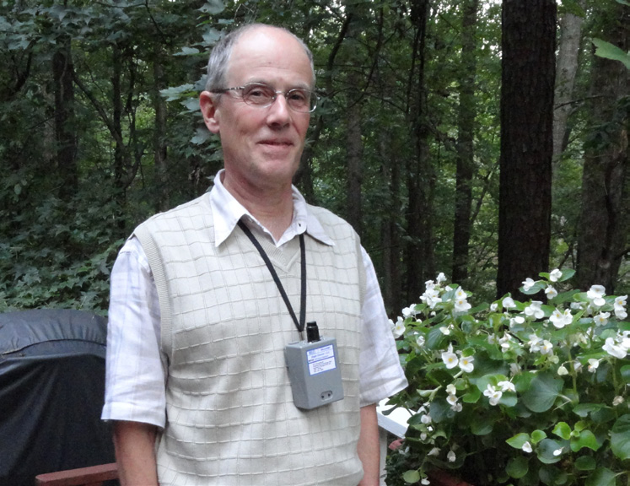
Notes:
Personal air samples were collected with these personal air monitors.

Slide 12
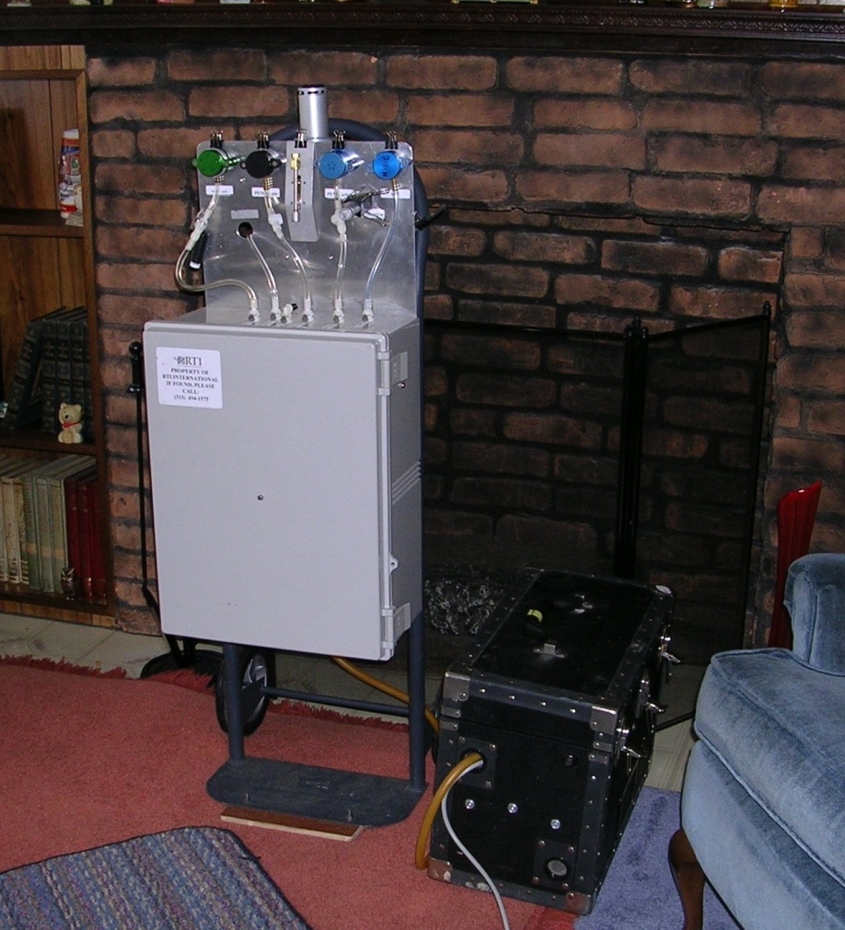
Notes:
Example of the Indoor Monitoring Platform being deployed during the IRPP Study

Slide 13
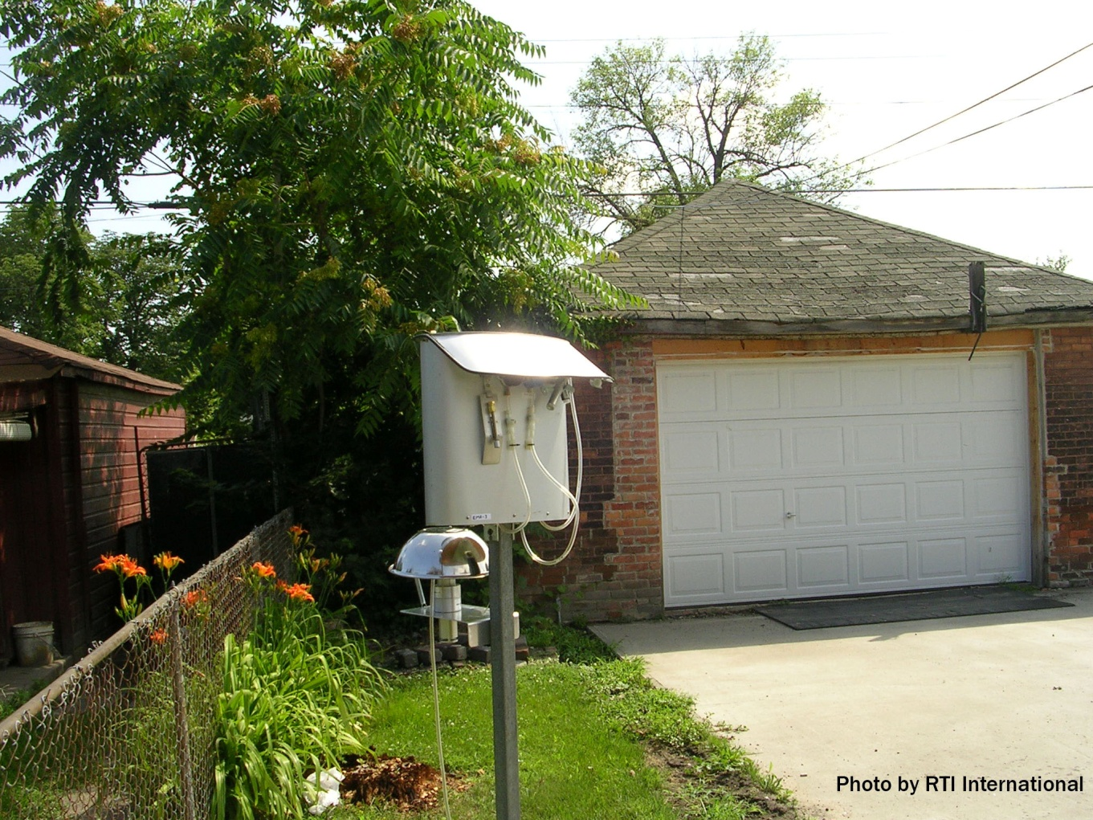
Notes:
Example of the Outdoor Platform Deployed at Residences and Fixed Sites During the IRPP Study

Slide 14
Sample (Biological)
Hair, urine and blood.
To determine the levels of metals such as arsenic, cadmium, mercury, lead and volatile organic compounds (VOCs) in the participant’s bodies.
Notes:
Now we come to the biological samples. A licensed DHSS nurse collected blood, urine, and hair samples on the first day of sampling platform setup at a participants’ house.
The VOCs listed in the study design will primarily be inhalation exposures.
Metals could be inhalation or ingestion.
The biomonitoring will help determine current exposure levels of the population being studied.

Slide 15
Questionnaires
Participant survey
  age
  weight
  ethnicity
  employment status
Residence survey
  age of the home
  duration of living at the current residence
  type of heating/cooling system
  number of gas appliances
Time-activity diary, Daily exposure questionnaire
Notes:
In addition to the airborne pollutants being measured by the indoor, outdoor and personal monitors, participants, with the assistance of the field team, will complete four questionnaires to aid with interpreting their exposure data.
A participant survey was administered once to gather basic information about the participant, including their age, weight, ethnicity, and employment status.
A residence survey, administered once, collected background information on the participant’s home. Type of information collected will include the age of the home, duration of living at the current residence, type of heating/cooling system, and number of gas appliances.
Time-activity diary tracked the participant’s location and activity level on an hourly basis.
Daily exposure questionnaire gathered information on the participant’s specific daily activities to assess behaviors that influence their exposure

Slide 16
Analyses
Analysis of biological samples will be conducted by the Delaware Public Health Laboratory (DPHL).
  Metals (urine and blood)
  Volatile organic compounds (blood)
Environmental samples will be analyzed at RTI.
  particulate matter
  metals such as selenium, arsenic, mercury, nickel
  black carbon
  second hand smoke
Notes:
Now we come to the analyses of the samples.
Biological samples- At present, Metals (urine & blood) and Volatile Organic Compounds (blood) will be analyzed as these are certified, validated, and current testing methods being used in the laboratory.
Hair samples will be archived to be analyzed at a later stage when DPHL acquires the preparation systems for hair analyses.
All biological samples will be archived. The next two slides will show the list of the analytes being assessed in the biological samples.
For environmental samples-All PM_{2.5} filters will be archived. The analyses to be conducted on the PM_{2.5} filters are nondestructive. As a result, all PM_{2.5} filters will be archived in case DNREC decides to conduct further analyses on them. Filters will be stored at 4°C in refrigerators located at RTI.

Slide 17
Notes:
Table shows the Volatile Organic Compounds and Metals to Be Analyzed in Blood and Urine Samples

Slide 18
Notes:
Table shows the Volatile Organic Compounds and Metals to Be Analyzed in Blood and Urine Samples ( continued).

Slide 19
Results
Phase One Preliminary results: March 2012.
Full report from DNREC by March 2013.
Summary of environmental results: provided in writing following the end of each monitoring season.
Results of the biological measurements: provided to the participants if the DPHL analyses reports measured concentrations exceed ‘national standards’.
Notes:
Preliminary results will be available for Phase I by March 2012
A full report will be available from DNREC by March 2013.
Results of the biological measurements made during this study will be provided to the participants if the Division of Public Health Laboratory (DPHL) analyses reports measured concentrations exceed ‘national standards’.
DPHL has provided a list of analyte levels –the level at which biological results will be of concern for reference.
It is to be noted that definitive standards are available for only a limited number of analytes being tested.
A letter providing the results will then be mailed to the participant.
Help will be provided in understanding what these excessive levels mean.
Results of individual lab tests-even if not above national standards- will be made available to participants upon request.

Slide 20
Cost
Pilot study
  $300,000
Proposed State wide study
  less than $10 million over a five year time period.
Notes:
The cost of the pilot study is roughly $300,000.
As we build capacity within our own staff and facilities we may be able reduce the cost of the statewide study, but currently the proposed cost is less than $10 million over a five year time period.

Slide 21

Future Directions
Statewide study
Monitoring and assessment based on baseline data

Slide 22

Thank You!

