Slide 1
Trends in Tobacco Use
Deborah P. Brown
CEO, American Lung Association of the Mid-Atlantic

Slide 2
Source: Delaware Department of Education, Youth Risk Behavior Survey (YRBS), 1999-2009.
* Current smoking = any smoking during past month
** Regular smoking = smoking 20+ days of past month

Slide 4
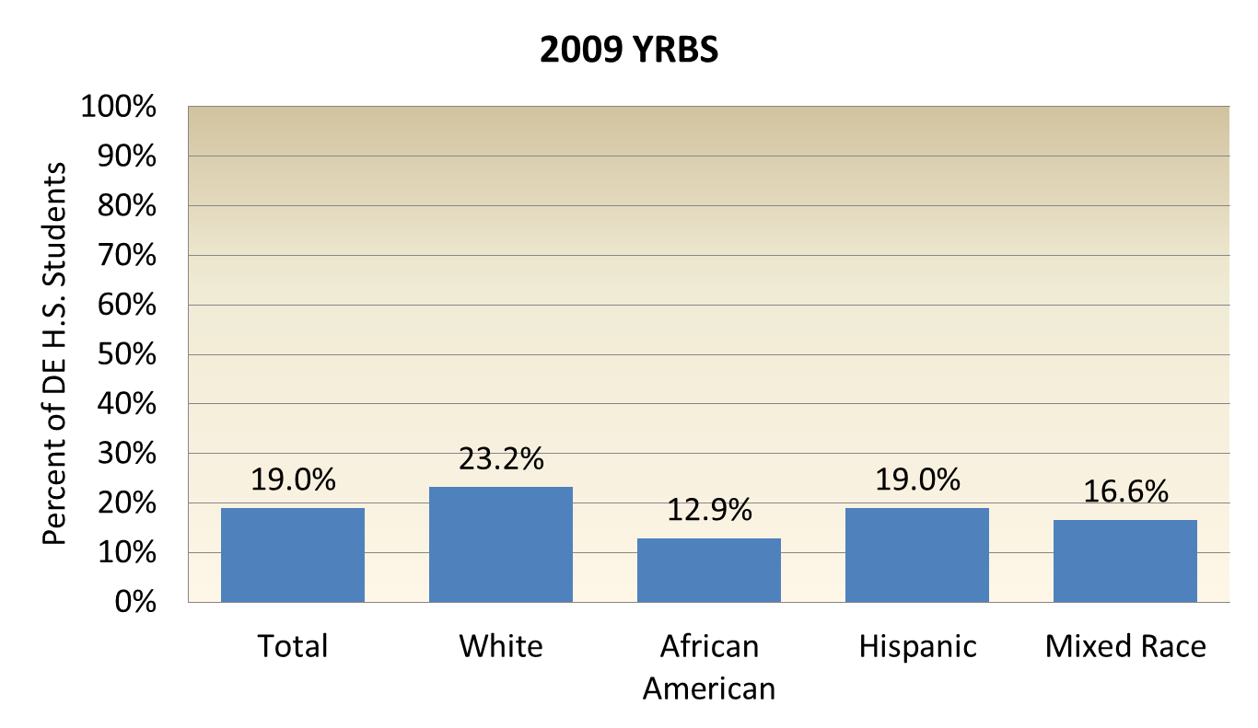
DE H.S. “Current Smoking” x Race, Ethnicity
Source: Delaware Department of Education, Youth Risk Behavior Survey (YRBS), 2009.
Current smoking = smoking on one or more of the past 30 days.

Slide 5
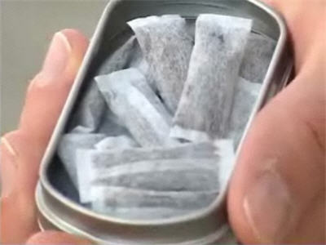
Other Tobacco Products
2009 High School YRBS | All Students | Male | Female
Smoked Cigarettes Past Month | 19% | 18.7% | 19.1%
Smoked Cigars, Little Cigars or Cigarillos Past Month | 11.8% | 14.5% | 8.6%
Used Chew, Snuff or Dip Past Month | 6.8% | 10.4% | 2.8%
Total Tobacco Use Past Month | 23.2% | 25.1% | 21.1%
4.2% of public high school students don’t smoke cigarettes, but use other tobacco products.

Slide 7

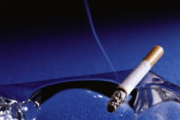


Slide 8
Preliminary look at new data . . .
Indicates significant increases in adult cigarette smoking in 2010 and 2011 – especially among young adults 18-34.
Some increase due to methodology changes – more accurate survey samples and weighting.
Other possible explanations:
  Impact of recession (traditionally causes increase)
  Industry marketing to young adults
  Renewed glamorization of smoking by media & role models
  Cuts in prevention funding

Slide 9

Is smoking becoming a sign of youth rebellion again?
Lady GaGa at the 2011 MTV Video Music Awards. The audience cheered her smoking!

Slide 10
Second-Hand Smoke
15% of adult still say they were exposed to second-hand smoke at work, however . . .
  14% of those respondents were exposed in work sites outside of Delaware.
  60% of those who reported work site exposure were exposed in outdoor work areas;
  29% said they were exposed outdoors at entrances;
  7% said they were exposed in indoor areas (0.8% of all respondents);
  1.8% said they were exposed in their home-based work site.
Second-hand smoke data source: DHSS, DPH, Adult Tobacco Survey (ATS), 2010. The ATS includes a cell phone sample, but uses standard weights.

Slide 11
Other 2nd-Hand Smoke Exposure
21.3% of adult Delaware residents said they were exposed to tobacco smoke in their homes during the past week.
78.7% of Delaware adults said smoking is not allowed in their homes.
15.2% of Delaware adults said they were exposed to tobacco smoke in a motor vehicle during the past week.
Source: DHSS, DPH, ATS, 2010.

Slide 12
Attitudes About Other Products
Tobacco Product | Less Harmful Than Cigarettes | Just as Harmful As Cigarettes | More Harmful Than Cigarettes
Chew & Snuff | 8.2% | 79.9% | 11.9%
Little Cigars | 7.6% | 84.8% | 7.6%
Regular Cigars | 9.4% | 77.8% | 12.8%
Hookah Pipes | 11.2% | 80.9% | 7.9%
Regular Pipes | 14.6% | 77.1% | 8.3%
Source: DHSS, DPH, Adult Tobacco Survey (ATS), 2010, which includes knowledge and attitude questions. The ATS uses similar methodology to the BRFSS, but has a smaller sample. It included a cell phone sample, but used standard weights.

Slide 13
So….
This is good news right???

Slide 14
Tobacco Industry Strategy Changes
Smoke-free Laws
Cigarette Excise Taxes
Heavy marketing to young adults
BUT… they will fight an excise tax on other tobacco products.

Slide 15
Other Tobacco Products (OTP)
    Any non-cigarette tobacco product
      Cigars
      Chewing tobacco
      Snuff
      Roll Your Own ( RYO)
      Snus
      Pipe tobacco
      Cigarillos
      Newer Products
Notes:
As you all know a cigarette contains about 9 mg of nicotine – some gets burned off so really only get about 1 mg per cigarettes. Ask you to keep this in mind as I go through the next few slides.

Slide 16
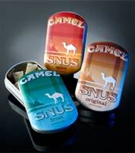
Notes:
SNUS--
Flavored looks like a teabag between lip and gum
No spitting
Alternative to CIAA laws
Tins look like cell phones
Sold in refrigerator – weight vs WS,
Cheap 2.00-2.50
Keep Refrigerated– keeps moisture out so can be taxed at a lighter weight and will be cheaper
Tin of snus weighs .6 grams for the total weight. CAMEL says that SNUS contain 8 mg of nicotine– is this per pouch or per gram? Either way not good.

Slide 17
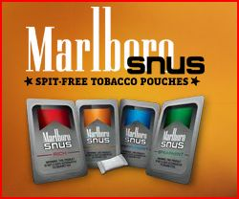
Notes:
Marlboro website originally said 3.9 mg per pouch now upgraded to 7.75 mg per pouch or gram? Again not sure what this means.
Creates a dual user
1.49-1.79

Slide 18
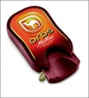
Notes:
Show you a couple of products that are being test marketed.
First show you how the product was originally test-marketed. Send around so you can see the packaging b/c that is important to the end result.
Originally test marketed in Portland OR, Columbus OH, and Indianapolis, IN. RJR said it learned what it needed to know – namely that the packages were too complicated to get into—
So they took them off the market to repackage-- easier to get into for children— Test marketing in Denver CO and Charlotte NC Fresher look and easier to open.
Each pellet contains 1 mg of nicotine--- 1 mg can make an infant or a small child vomit or nauseaous
5 mg can send into convulsions

Slide 19
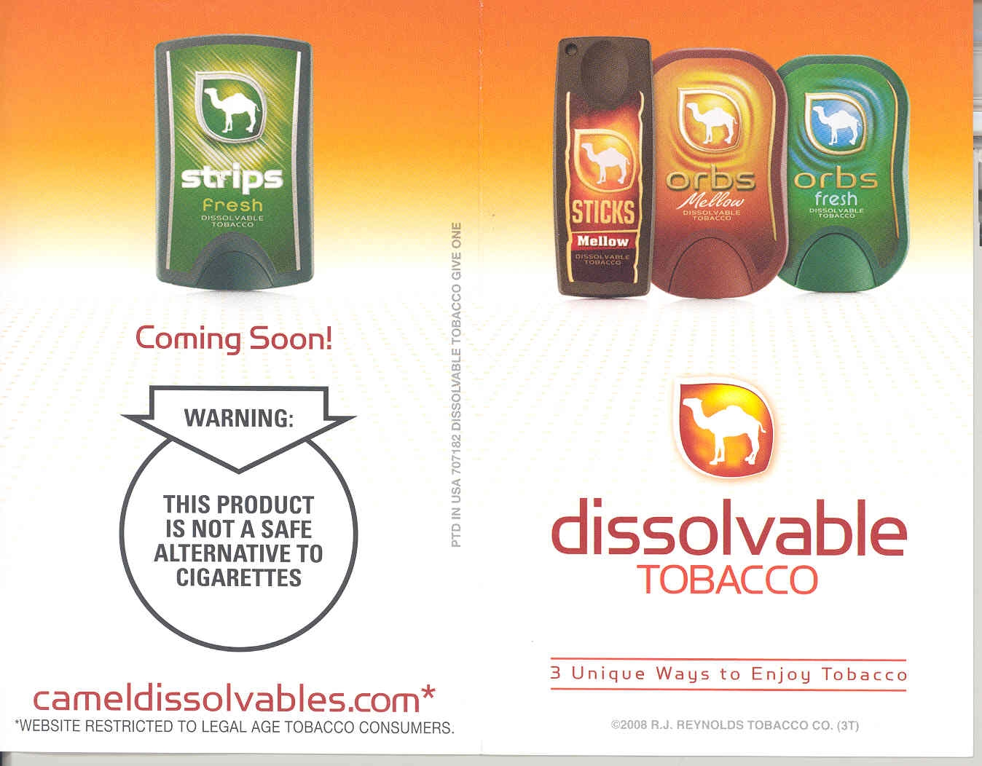
Notes:
Strips-- .6 mg of nicotine per strip
Sticks – 3.1 mg of nicotine

Slide 20
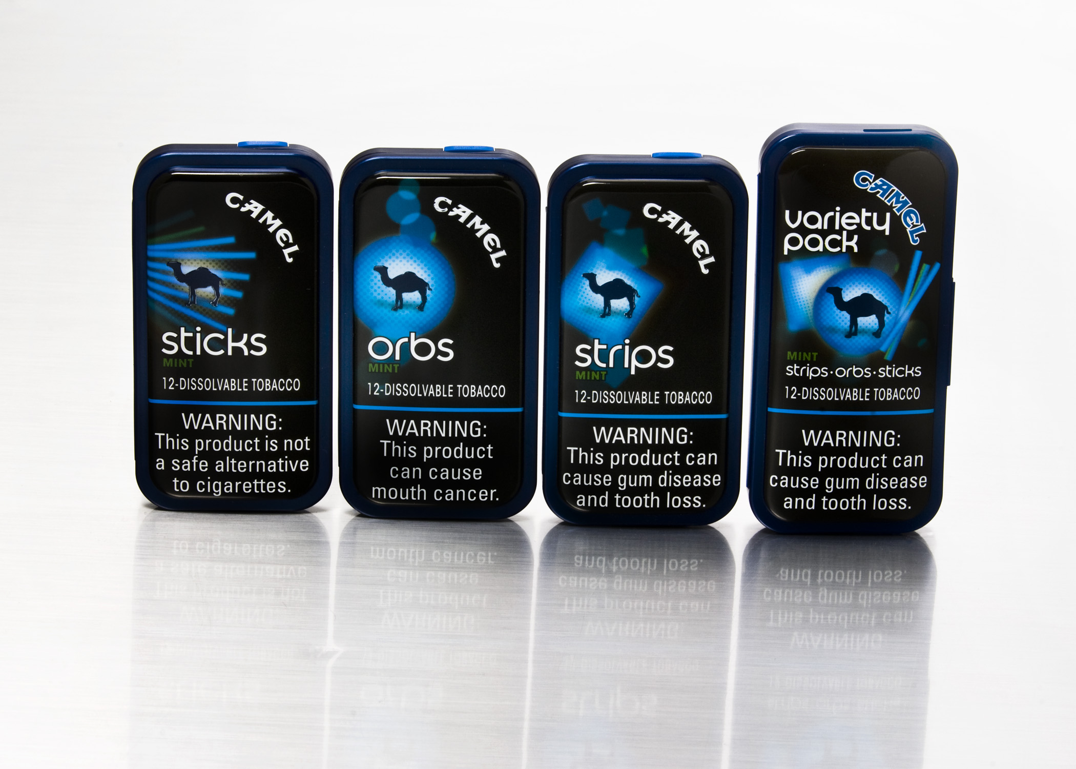
Notes:
New packages—branding– easier to open
Now even get an variety pack so you can take you pick of poisons.

Slide 21
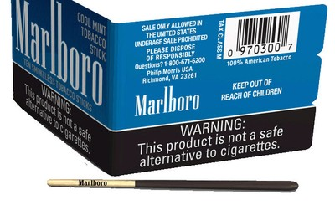
Notes:
Marlboro also has dissolvables being test marketed in Kansas now– calling them a smokeless tobacco stick. 2.5 inches long, 10 in pack, 2/3rds of the stick is coated in tobacco . 4 flavors. Swallow the product.
Great way to get people, including children, to use tobacco and to help those who want to quit be even more difficult.
Interesting thing is FDA must review any new tobacco products to make sure they are consistent with protection of public health. PM tired to slip this in before the March 22 deadline after which FDA had to review all new products before they could go on the market.
Now, that said, there’s going to be some interesting interpretations and other positioning regarding substantial equivalence. That around the magical date of February 15, 2007 – which has to do with whether a product was on the market by that date – or if the one that is being introduced is substantially equivalent to one that was on the market by that date. If a product or its substantial equivalent wasn’t on the market by that date, it has to apply to FDA to remain on the market. That may knock some of these products outta here.
As mentioned the Tobacco Products Scientific Advisory Committee is required to submit its report on dissolvables to FDA by March 23, 2011. I anticipate a flurry of attention & focus on these products between June and then as TPSAC acts.

Slide 22
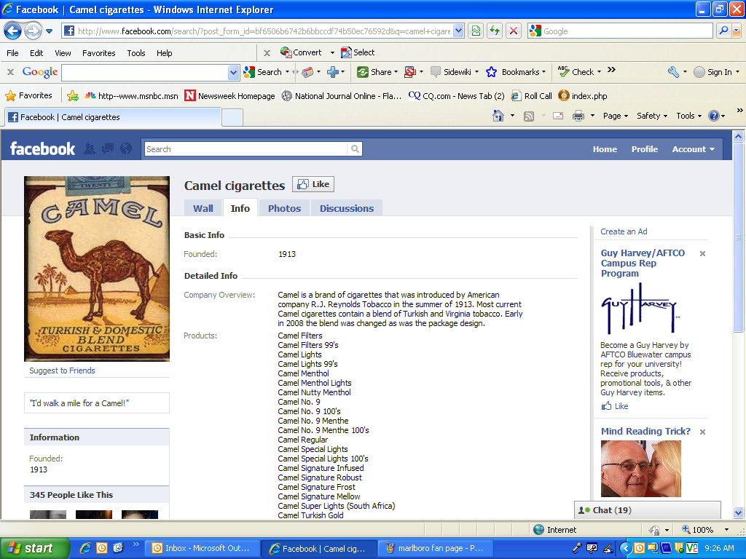

Slide 23
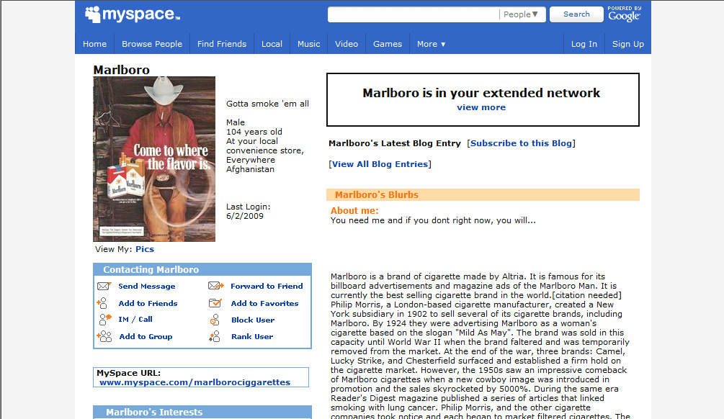

Slide 24

Our Role
We
Become
the
Watchdogs!

Slide 25
We will breathe easier when the air in every
American community is clean and healthy.
We will breathe easier when people are free from the addictive grip of cigarettes and the debilitating effects of lung disease.
We will breathe easier when the air in our public spaces and workplaces is clear of secondhand smoke.
We will breathe easier when children no longer battle airborne poisons or fear an asthma attack.
Until then, we are fighting for air.

