Slide 1
Putting it all in Perspective
Random Thoughts from a Has Been
Notes:
Introduction:
It is a pleasure to have this opportunity, who I used to be, who I am now
The day will be full of data, so I will try to not overwhelm you with data, but I want to make you think, maybe even push you a little and make you uncomfortable
This will be a Retrospective, Comparison, and Prospective

Slide 2
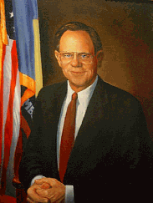
Retrospective
August 17, 1987 – 25 years ago
Mike Castle was Governor
Tom Carper was Congressman
Delaware was #2 in CANCER MORTALITY
Notes:
I came on the scene on August 17, 1987, 25 years ago.
At that time Mike Castle was the Governor and Tom Carper was our Congressman.

Slide 3
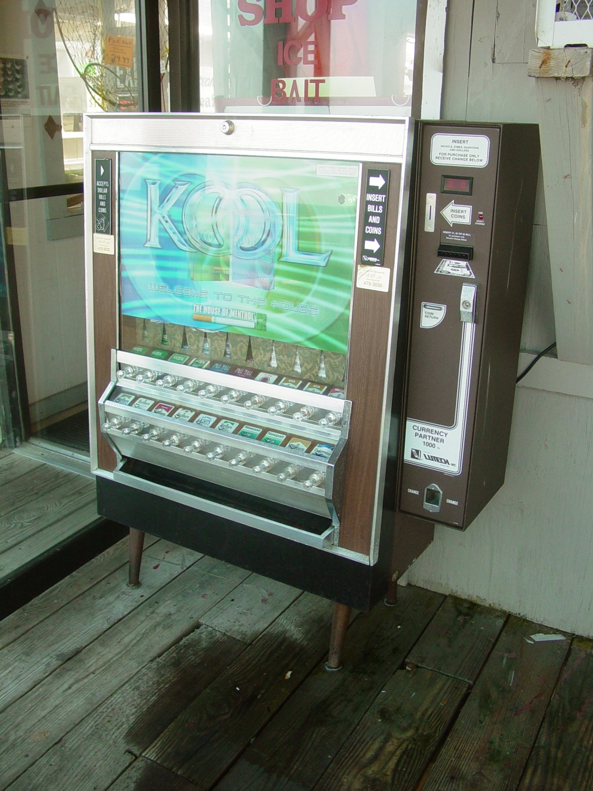
Retrospective
August 17, 1987 – 25 years ago
Delaware was number 2 in cancer mortality
Adult smoking rate was about 25% - there were cigarette vending machines everywhere, including Legislative Hall. You could even give away free cigarettes!
Notes:
Delaware was number 2 in cancer mortality, only after Washington DC, today we are 12^{th.}
Adult Smoking rates was about 25%
There were vending machines everywhere, including Legislative Hall.
Cigarettes were given away for free.
Dover Downs was full of smoke!
American Cancer Society was here to help

Slide 4
There was NO
Screening for Life Program or Federal Breast Cancer Treatment program
Mammography Van
Smoke Free Air Legislation
Gold Rating from NAACCR for Delaware’s Cancer Registry
Notes:
At that time, there was no:
No, Breast and Cervical program- Screening for Life
No, Mammography Van
No, Federal Breast Cancer Treatment Program
No, Smoke Free Air Legislation
No, Insurance coverage for Mammography, colon, prostate, cervix
No Mammography quality standards
No, North American Association of Cancer Central Registries (NAACCR) Gold rating for Cancer Registry

Slide 5
The Cigarette tax was $.14 per pack - now it is $1.60 and slightly above the national average
Notes:
Cigarette tax was $.14 - now it is $1.60 and slightly above the national average.
But let’s remember that there are a lot of states like VA where the tax is only .30 per/pack or Louisiana at .36 per/pack.

Slide 6
There was NO
Smoke Free properties like schools
Delaware Quitline
Delaware Cancer Treatment Program
Media awareness campaigns about smoking, although we have less funding than we used to have…
Notes:
No, Smoke Free properties, like schools and casinos
No, Helen F. Graham Cancer Center or Tunnell Cancer Center
No, Nurse Navigators
No, Colon cancer screening program
No, insurance coverage for routine care during clinical trial
No, Delaware Cancer Treatment Program
No, Delaware Quitline and no youth programs for keeping kids from smoking
No, media awareness campaigns about smoking, although at the moment there is less funding than there used to be

Slide 7
What we have now:
Organizations , coalitions and groups such as:
Delaware Cancer Consortium
Kick Butts Generation
American Cancer Society - Cancer Action Network
Governor’s Council on Health Promotion and Disease Prevention
Center for Health Promotion
IMPACT
Delaware Pain Initiative
Notes:
Smoke Free Class of 2000
ACS CAN
IMPACT
Kick Butts Generation
Cancer Consortium
Delaware Breast Cancer Coalition (DBCC)
Biden Breast Initiative
Cancer Care Connection
De Pain Initiative
The State Chamber’s Health Advocates program
Cancer Support Community (Wellness Community)
DE HEAL
Governor’s Council on Lifestyle and Fitness
LT Governor’s Challenge
DelaWell
Center for Health Promotion
The News Journal Tuesday Health Section
(And probably some that I have missed)

Slide 8
We had to ADVOCATE!
We had to provide support services
We had to create policy
We had to create financial investments for our future
We had to develop treatment facilities with world class talent
Notes:
In time we have learned to advocate,
we have provided support services,
we have created policies,
we have created financial investments, and
we have created world class treatment facilities that attract world class talent to decrease the burden of cancer in Delaware.
So where has that gotten us?

Slide 9
Comparison
American Lung Association issues Delaware’s report card:
A – Smoke free air
B – Tobacco Prevention
C – Cessation coverage
C – Cigarette tax
Tobacco KILLS 1,200 people a year in Delaware
CDC recommends we spend $13.9 million on tobacco prevention funding we are at $9 million
Notes:
Comparison:
How do we stack up against some of the other states:
American Lung Association gave Delaware an A, B and 2 Cs in their latest State of Tobacco Control Report, 10th edition.
A for smoke free air,
B for tobacco prevention,
C for cessation coverage and
C for cigarette tax.
Tobacco kills 1,200 people a year in Delaware. The CDC recommends we spend $13.9 mil on tobacco; Delaware’s tobacco prevention is $9 million. The only two states that fund tobacco control above the recommended CDC level are North Dakota and Alaska. Delaware is about 59.5%.
If all the states maintained the suggested target funding levels, we would see 5 million fewer smokers.
An interesting point to ponder is that since the Master Settlement Agreement began, the tobacco industry has increased their marketing dollars by 85%. In other words, the tobacco industry spends 25 times more than all states spend combined.
We can’t afford to let a dollar of what we are doing here in Delaware be lost.
Tax is $1.60 and only 15% of wholesale price for other tobacco products.
Deb Brown, CEO for our regional American Lung Association said, “Delaware has done a fairly good job and has made substantial progress, but we still have some work to do.”
Regionally, tobacco tax is quite a bit higher than Delaware’s at $1.60 (20th place). Currently New Jersey $2.70 Pennsylvania is at $1.60 and Maryland is at $2, but it is good chance that it will go to $3 and they will be significantly increasing their tax on other tobacco products.

Slide 10
Pain & Palliative Care
Delaware lacks hospital capacity to care for all patients
Controlled substance prescriptions for pain are only valid for seven days, this is a barrier for our patients
Prescriptions can only be written for a thirty day supply, adding one more barrier to our patients
Notes:
In Pain and Palliative Care, Delaware currently has F, primarily because we don’t have enough capacity in Hospitals to care for all the patients that could qualify, although the measurement system for this is at odds with our local interpretation.
From the pain perspective, we only allow prescriptions for controlled substances to be valid for 7 days. This is a barrier for some folks that might not be able to afford their prescriptions.
Also the issue that prescriptions can only be written for a 30 day supply. This adds more barriers for folks that live at a distance from their physicians.

Slide 11
We Can Do Better
State lawmakers play a critical role in guaranteeing access to care through -
State-funded screening programs
Medicaid coverage for low-income populations
Health benefit exchanges
Notes:
State lawmakers play a critical role in guaranteeing access to care through state-funded screening programs, Medicaid coverage for low-income populations, and the development of health benefit exchanges as outlined in the Affordable Care Act.
Breast and cervical cancer program nationwide only reaches 1 of 5 women that would be eligible.
We can do better!

Slide 12
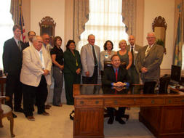
Prospective
State of State Address by Governor Markell:
Total ban on smoking on state agency campuses.
Shift Medicaid money to prevention services to decrease overall costs.
Spend on bike and hiking tails to invest in state health infrastructure – decrease in obesity and lack of physical activity
Notes:
Prospective:
State of the State address by Governor Markell:
The Governor proposed expanding a total ban on state agency campuses. This would add to the smoke free acreage in DE. Places like Astra Zeneca, Christiana Care, AI DuPont Hospital and theoretically all school property have already done this.
b. The Governor is very concerned about our rising health care costs; Currently Delaware spends over $600 million for Medicaid to cover 200,000 lives. If we could shift some of that to more prevention services, we would begin to see a decrease in overall costs within a year or two.
c. The Governor proposed spending $13 million on bike and hiking trails. One political leader remarked, Why in the world does DE need $13 million in bike trails? I was hopeful that there would be lots of letters from health advocates explaining why we need this funding. I have seen none. This investment is not just an investment in the state’s recreation infrastructure, but also in the health infrastructure. We have all seen the maps on obesity in this state and the lack of Physical Activity.
Come on people, we need to make some noise here!

Slide 13
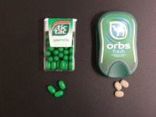
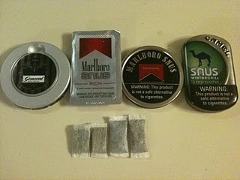
Emerging Issues
Need tax equity on tobacco products known as OTPs.
Lower priced
Desirable to young people
Increase in youth nationwide 15% between 2002 – 2009
Notes:
Emerging issues:
- Need tax equity on tobacco products, known as Other tobacco products or OTPs. These alternative forms of tobacco are much lower priced, making them very affordable and desirable amongst the young people. Use of these products by our youth nationwide increased 15% between 2002 and 2009. Tobacco is coming in all sorts of new shapes and sizes. If you see Deb Brown from the American Lung Association, ask her to show you her many samples of new and different products. All of them aimed at your kids—tic tacs, Listerine sheets, flavors. The tax on these products needs to be equal to that of cigarettes.
- Medicaid coverage for cessation. We have been talking about this in our Tobacco and Other Risk factors committee for years. There is a discrepancy in the business process. The issue is if you go thru Medicaid you need prior authorization for cessation products but if you just call the quitline and don’t say you are a Medicaid patient, you can get the cessation tools for free.
- E cigarettes - a nicotine delivery device. Advocates still are not sure what position to take. The need to be trained on the science about E cigarettes. This trend needs to be watched very carefully.

Slide 14
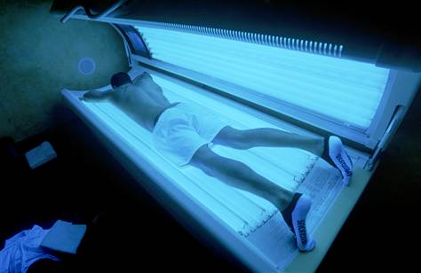
Emerging Issues
No child under 18 should never be allowed to use a tanning bed unless it is with the express order of a physician.
Eliminating food deserts
Expanding screening for chronic disease risk factors
London Associated Press
Published Study:
Tanning beds can be as deadly as arsenic
Notes:
Tanning beds - no child under 18 should ever be allowed to use a tanning bed unless it is with the express order of a physician.
The Minnesota Cancer Surveillance System found a strong association between indoor tanning bed use and the occurrence of melanoma.
The International Agency for Research on Cancer says that indoor tanning beds are a probable human carcinogen.
There are 10 states looking at banning the use by children under 18. California was the first state to pass this type of legislation.
West Virginia and North Carolina are actively pursuing similar legislation. Melanoma is the highest cause of cancer death in young woman 18-24.
Eliminating food deserts—an area without full service grocery stores and access to healthy foods, rural and inner city. This is an issue in rural and urban areas.
It is fascinating to see the map for Delaware and see where this is an issue. Some areas of Sussex County and inner city Wilmington are areas to watch.
In Utah, their Wisewoman Program provides low income and underinsured and uninsured women with chronic disease risk factor screening, lifestyle intervention and referral to include: BP, Cholesterol, diabetes, tobacco cessation, lifestyle counseling, healthy cooking, as well as breast, cervical and colon screening. Something for our Screening for Life program to consider
Connecticut is conducting a statewide survey and focus groups to identify the unmet educational needs of their health professional around palliative and end of life care.
We need to carefully monitor breast cancer screening data. We don’t want to this to get like vaccines; where people figure they don’t need it.
We need to stay up with technology changes, for example the all payer claims database will allow us to better track and understand the impact of screening compliance and treatment protocols on survivorship and quality of life
In looking at disparities, as we celebrate the elimination of health disparity in colon cancer, we need to really think thru how we can tackle the nutritional disparities in our communities and as well as access to safe physical activity venues.
A big question for the future, as we find more and more treatment for cancer becoming more individualized; is how will we deal with access, availability and affordability issues and keep them in balance.
As we begin to shift care from in hospital to out-patient, how do we determine reimbursement formulas, and how do we prepare family members to serve as caregivers for their loved ones.
What will be the needs of the cancer survivors going forward?
How do we ensure that we have enough health care professionals that are prepared and able to provide the care needed by our population?

Slide 15
Focus on Prevention
Change in Care Model improve health in Delaware and the nation
Notes:
There is a need for a change in our model – take for example dentistry in the 1950s, when I was a kid, people had lots of cavities. Unfortunately many folks had no teeth by time they were 60, but there were dentists that were there to treat those in need. Thankfully today, my grandchildren have no cavities. Dentists are in the business of prevention: fluoride, floss, cleaning treatments, gum repair. The philosophical model changed, the reimbursement system changed, public policy to fluoridate water, the public’s expectations have changed. We need to create the same kind of model and expectations around cancer prevention.

Slide 16
Need for Coordination & Cooperation
What could happen if we all got involved in one room and shared the funding?
Does anyone know all the available money in Delaware for prevention?
We need coordination, cooperation, transparency and commitment from all -
WE EVERYONE!
Notes:
There is a need for coordination and cooperation.
We have a proliferation of councils, coalitions, and funds, but does anyone know who, what and how many organizations there are or what they do? There is the DCC, IMPACT, HEAL, Council on Health Promotion/Disease Prevention, DE Prevention Network, and the new Governor’s Council on Faith based organizations.
Does anyone really know where all the money for prevention is in the state? The money comes from many sources and goes into many silos. What could happen if we brought everyone involved into one room at one time and shared what we were doing and how much funding we had and from what source?
At our last Tobacco and Other Risk Factor Committee meeting, we learned that the Boys and Girls Club have received funding from a federal grant to work in the Dover community on substance abuse. Could we perhaps use the funds available more efficiently and effectively? For example, AstraZeneca (AZ) and United Way (UW) have come together in a 5 year initiative to equip young people in the state with the resources and tools to grow up healthy and successful. They have 3.4 million dollars. Has anyone in this room been involved?
Is anyone talking about nutrition, physical activity, tobacco control, immunizations for cervical cancer prevention with these folks?
Stone Soup story.
We need Coordination, Cooperation, Transparency and commitment from all the folds included in any “WE!”

Slide 17
Call to Action
Achieve and maintain a healthy weight throughout life – be as lean as possible. For those that are overweight or obese, losing even a small amount of weight makes a difference and is a place to start.
Adopt a physically active lifestyle, by limiting sedentary behavior and engaging in moderate to intense activity throughout the week.
Eating a diet including lots of fruits and vegetables, whole grains and limited processed and red meats.
Limit alcohol consumption, women one drink a day; men two a day – no you can’t save them all for the weekend.
Notes:
So, as I close, I want to issue one last challenge to each of you. I want to remind each of us of the updated guidelines on nutrition and physical activity for cancer prevention from the ACS:
Achieve and maintain a healthy weight throughout life—be as lean as possible.
For those that are overweight or obese, losing even a small amount of weight makes a difference and is a place to start
Adopt a physically active lifestyle, by limiting sedentary behavior and engaging in moderate to intense activity throughout the week
Eating a diet with includes lots of fruits and veggies, whole grains and limits processed and red meats
And limit alcohol consumption, which for us women is 1 drink (that is five ounces of wine or one beer), two for men a day. And you can’t save them up for the weekend.
Thanks to the entire Tobacco and Other Risk Factors Subcommittee for their brainstorming and input and Fred Gatto.
Special thanks to Eileen McGrath and Jeanne Chiquione from ACS for their assistance in getting my facts right

