Slide 1

PANO Advancing Healthy Lifestyles Coalition
December 12, 2023
AHL Coalition Quarterly Meeting
FACILITATED BY:
Devona E.G. Williams, PhD
President/CEO

Slide 2
Agenda
9:30 am Welcome and Introductions
        Lauren Butscher, PANO Administrator
9:45 am Committee Reports and Coalition Updates
        Coalition Website, Mike Cordrey
        Membership/Group Meet, Jayden Carr
        Annual Conference Resource Table Invitation
10:30 am Healthy Lifestyles and Mental Health, Emily Vera, Executive Director, Mental Health Association in DE
11:00 am Emotional CPR Preview, Oryx Cohen, Chief Executive Officer
National Empowerment Center
11:30 am Member Information Sharing and Networking
11:45 am Door Prizes!
11:45 am Wrap-Up and Next Steps
12:00 pm Adjourn

Slide 3

Vision
The AHL Coalition uplifts the well-being of all Delawareans and breaks down barriers to achieve healthy lifestyles.
Mission
The AHL Coalition brings together coalitions and partners to focus on healthy lifestyles and equity through the PANO lens to leverage and expand resources in the community.

Slide 4
Core Values
Inclusive. We embrace cultural inclusivity and work to understand and respond to different cultural needs of our counties and communities to ensure equitable access.
Build Trust. We provide a safe and respectful space for diverse community representatives, and listen to communities to build trust and buy-in. Our efforts support community engagement and belonging.
Collaboration. We practice shared responsibility, collaboration, and leadership with our member and partner organizations.
Collective action. We strive to effect meaningful broad systems and cultural change of organizations and individual attitudes to impact social determinants of health and improve health outcomes.

Slide 5

Priorities for Year 1
The most pressing need relating to health equity is to increase awareness.
The area of focus should be mental health and wellness.
The top outcomes for year one should be increased community engagement.

Slide 6

Strategic Goals
Collaboration/Partnerships: Engage coalitions and key representatives across the health system with a PANO focus to serve as a repository, knowledge sharing and networking vehicle.
Community Outreach Engagement and Access: Provide outreach opportunities to increase access to existing programs and services with a PANO focus, regardless of income, race, ethnicity, gender identification, age, ability, citizenship status, or geography.
Program Development linked to PANO: Identify gaps in services and programs that increase access to PANO related services that reduce health disparities, improve outcomes, and affect system or cultural change.
Marketing and Communication: Develop a marketing plan for existing programs linked to PANO and other Coalitions that promote equity and help reduce health disparities.
Policy: Advocate for policy systems or environmental changes with a PANO focus that increase equitable access to health programs and services to increase access and reduce health disparities.

Slide 7

Committee Chairs
Collaboration/Partnerships | Community Outreach Engagement and Access
Kat Luebke, Chair Tanya Haley, Co-Chair | Peter Campbell, Chair
Program Development | Marketing and Communication
Heather Klemanski, Chair | Catalina Natalini, Chair Peter Campbell, Co-Chair
Policy | Conference Steering Committee
Karen McGloughlin, Chair Nancy Mears, Co-Chair | Lori Ciabattoni, Chair Tanya Haley, Co-Chair

Slide 8
Members

Slide 9
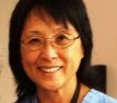
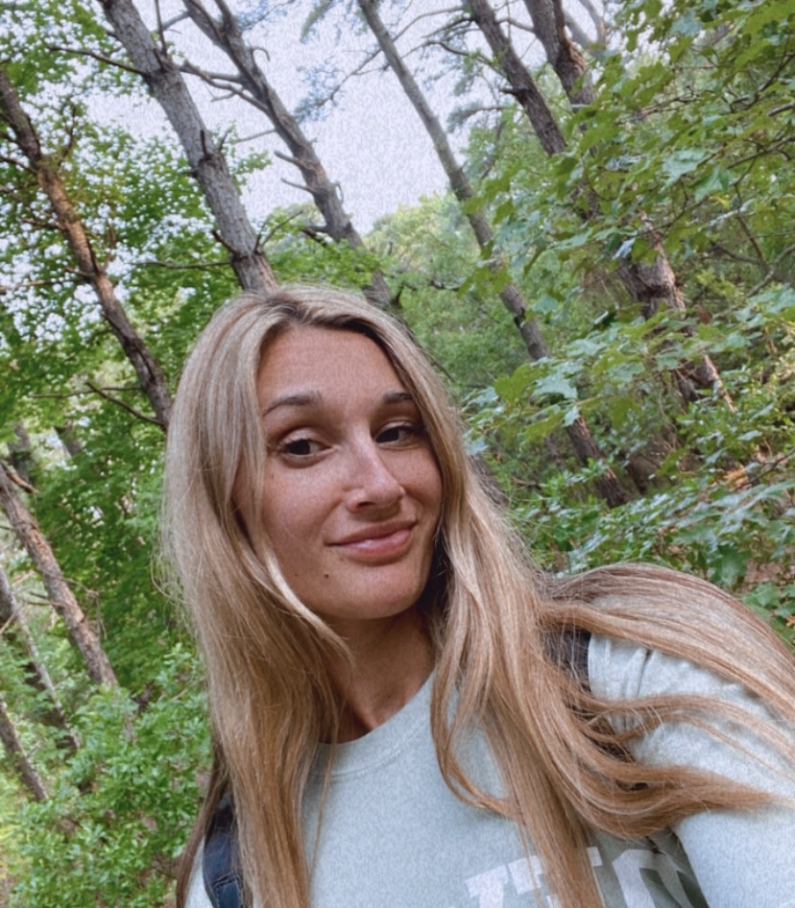
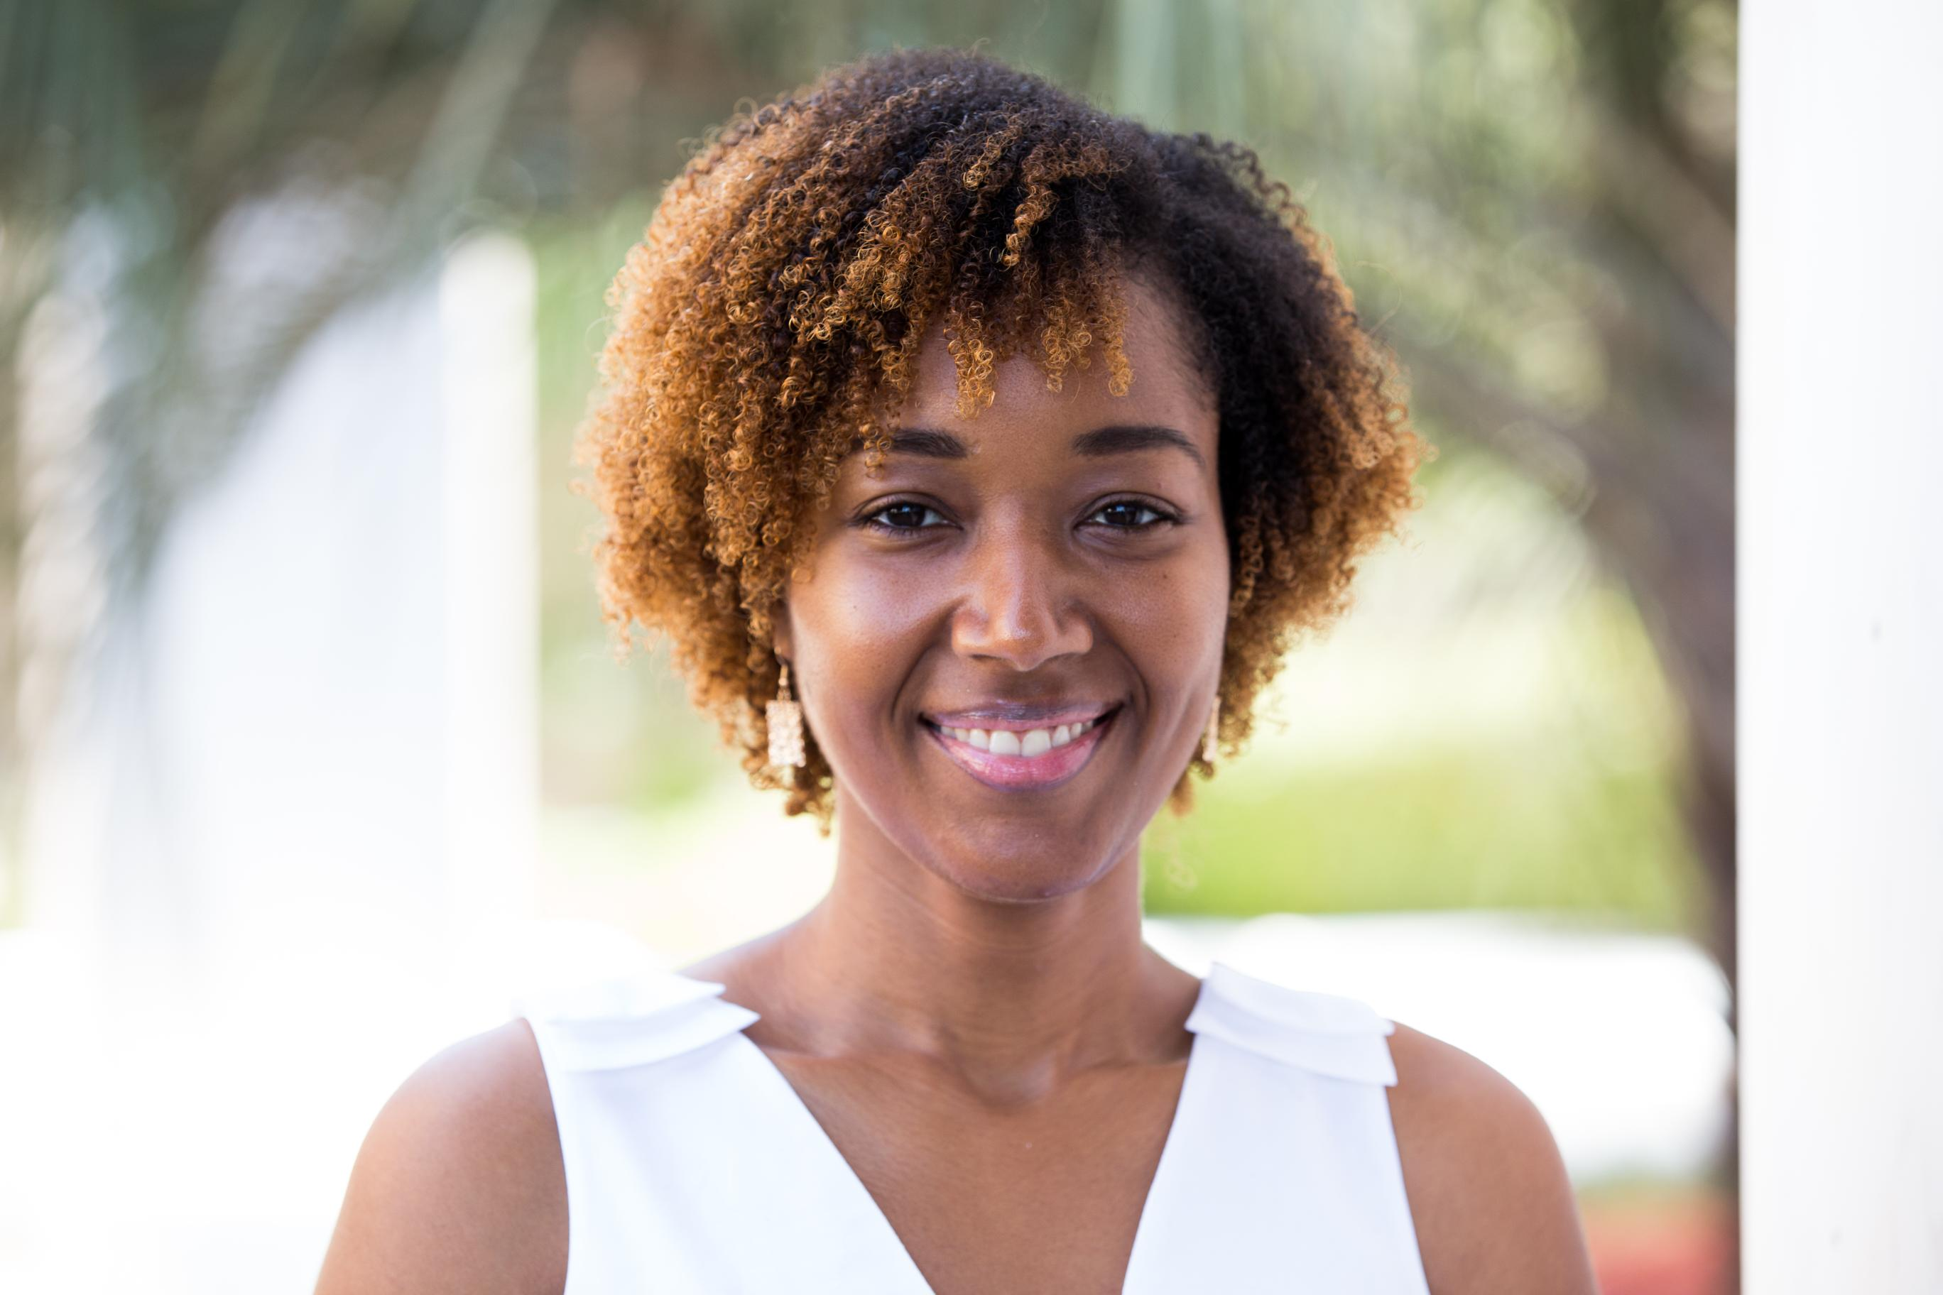
AHL Coalition Bloggers
Bet Wong
Bet Key Wong, MSN, RN, CNOR is a nurse, steward of good health, and social entrepreneur.
Founder and Board of Directors, Nurses & Neighbors
www.delawareinstitute.org
Christina Choma, RDN, LDN
Nutrition, Health & Wellness Coordinator, New Castle County
Delaware Department of Health & Social Services, Division of Public Health
www.dhss.delaware.gov/dph
Ebony Mapp,
Partner Liaison/Program Officer, Healthy Communities Delaware, Writing about: mental health, black mental health, healthy eating and community development happening across Delaware.
www.HealthyCommunitiesDE.org

Slide 10

AHL Conference Resource Table Opportunity
Information to share
Door prizes, give aways
Name, organization
Set up 7 am, break down 4 pm
Cost: Only $50

Slide 11

Healthy Lifestyles and Mental Health
Emily Vera, Executive Director Mental Health Association of DE

Slide 12
Emotional CPR, Oryx Cohen
Chief Executive Officer
National Empowerment Center

Slide 13

This Photo by Unknown Author is licensed under CC BY-SA-NC

Slide 14
Wrap Up and Next Steps
Summary of agreements reached
Next meeting March 12
  Leadership Team Reports
  Collaborations and Partnerships –short presentations from other coalitions
  Update on AHL Conference

Slide 15
Thank you!

